Slide 1
The Use of LiDAR Sensors on Counter UAS Drones
Jesse Brewster

Slide 2
What is a LiDAR Sensor?
LiDAR stands for Light Detection and Ranging.
Remote sensing method that sends pulsated laser to measure different distances from the sensor.
Can create a 3D model of an object or environment.
More accurate than radar because lasers are used in a straight down pattern instead of radio waves at an angle

Slide 3
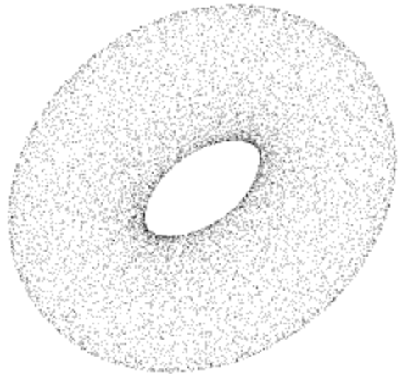
How Does LiDAR Work?
The sensor contains many lasers that aim out and pulse towards the object.
The time it takes for each pulse to bounce back to the sensor is measured thus calculating the distance based upon the speed of light.
There is a limited distance and angle that the LiDAR can pick up
The result is a point cloud of 3D data points:

Slide 4
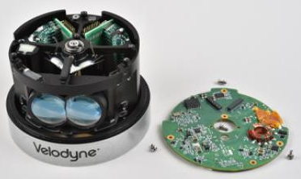
Components of LiDAR
LiDAR sensor units consist of:
Lasers
Scanners
GPS receivers
Internal Measurement Units (IMU)
Central Processing Unit (CPU)
Data storage systems
Motor for rotation of laser emitter
Notes:
LiDAR SENSORS: As the airplane travels, sensors scan the ground from side to side. The pulses are commonly in green or near-infrared bands.
GPS RECEIVERS: GPS receivers track the altitude and location of the airplane. These tracks are important for accurate terrain and elevation values.
INERTIAL MEASUREMENT UNITS (IMU): As airplanes travel, IMUs track their tilt. LiDAR systems use tilt to accurately measure the incident angle of the pulse.
DATA RECORDERS: As LiDAR scans the surface, a computer records all of the pulse returns. Then, these recordings get translated into elevation.

Slide 5
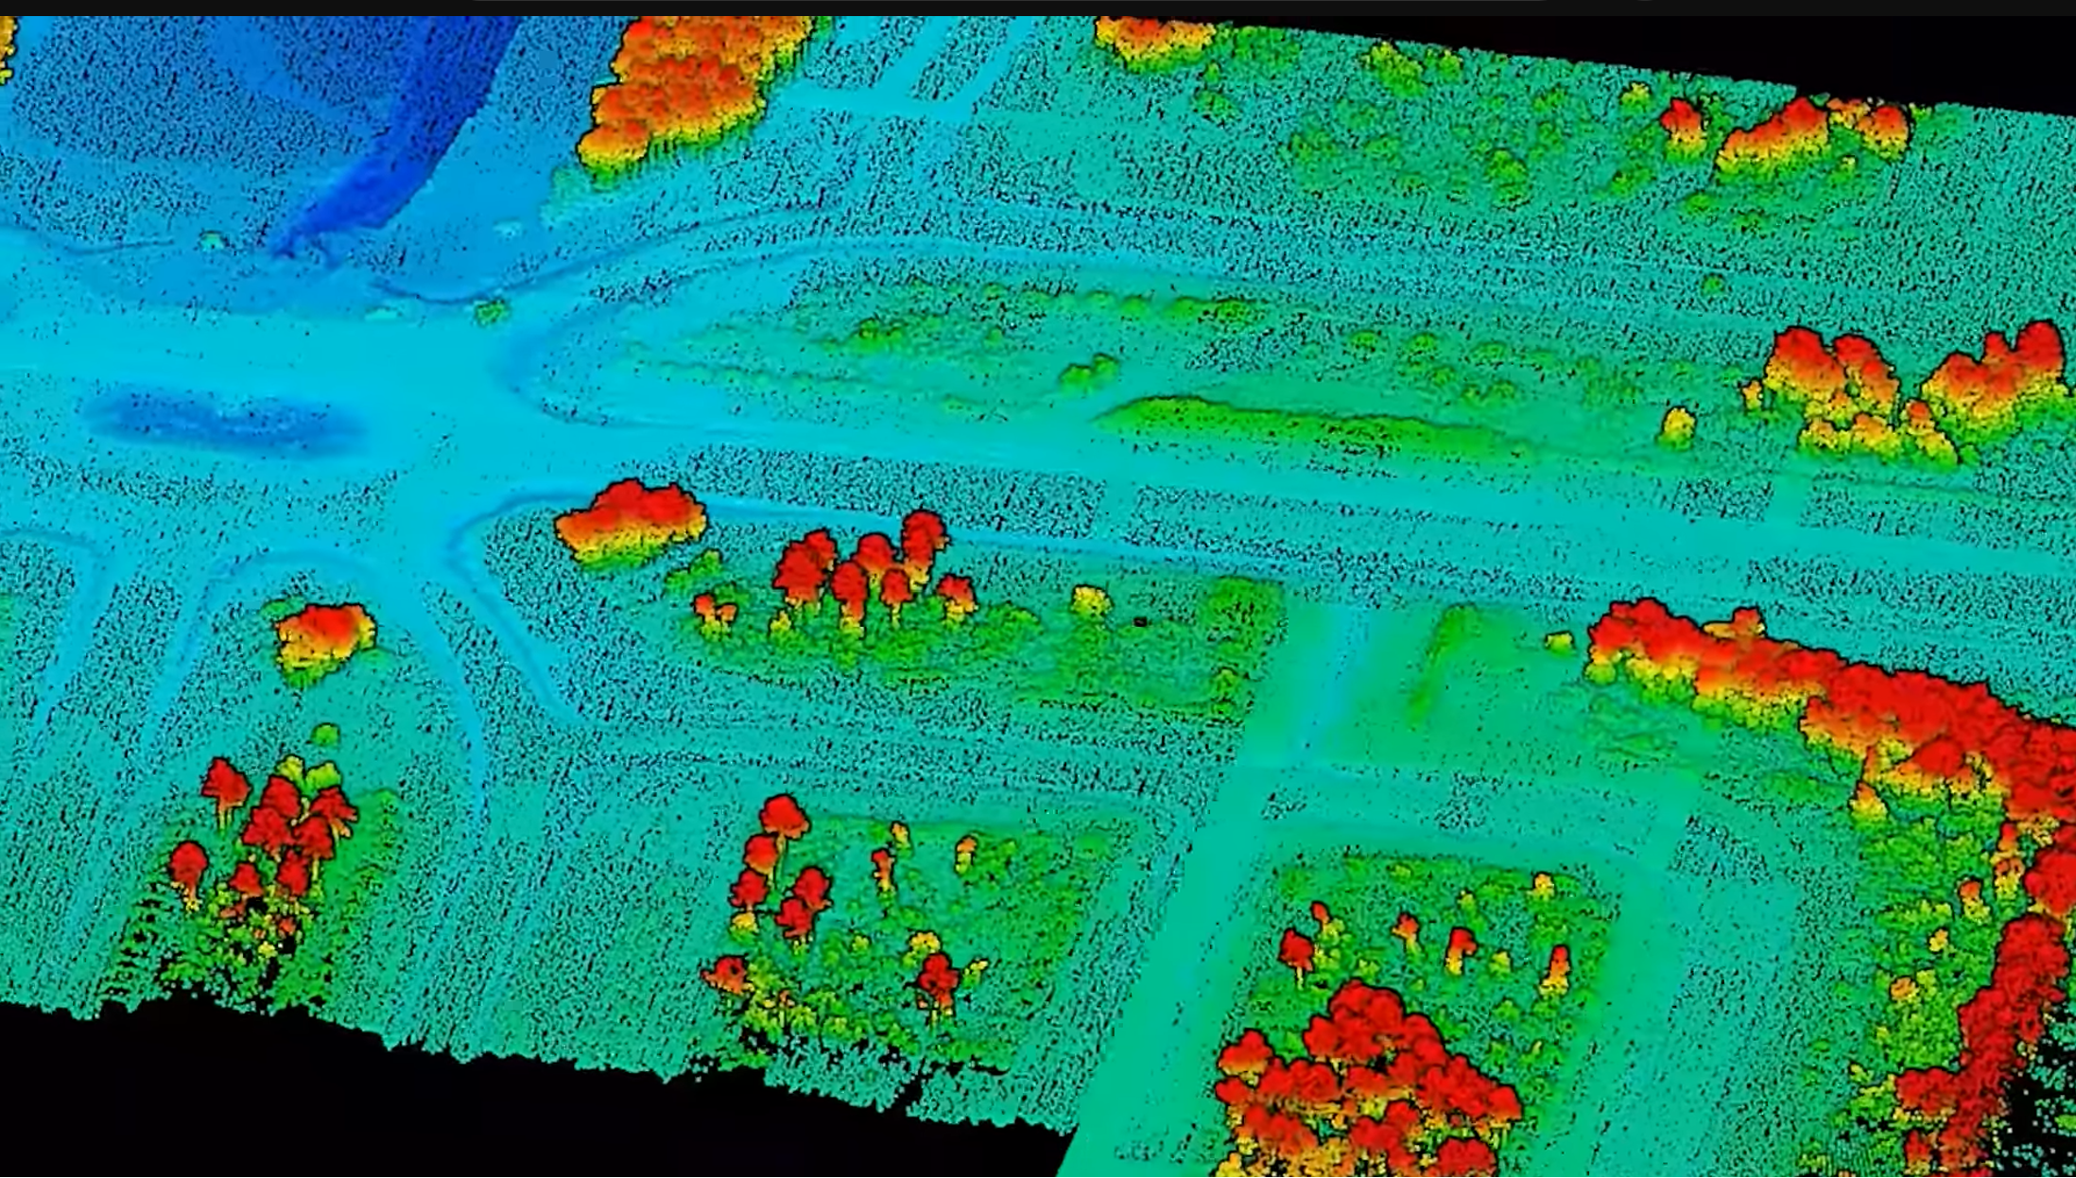
Different Applications of LiDAR Sensors
Mapping: LiDAR Sensors are used extensively for creating high-resolution 3D maps of terrains, buildings, and environments.
Surveying: Can be used in the planning of land development, city infrastructure, and expansion.
Airborne, terrestrial, and mobile LiDAR sensors are available depending on the application.
Notes:
Airborne – sensors used in planes or helicopters to get a
Terrestrial – land sensing and
Mobile

Slide 6
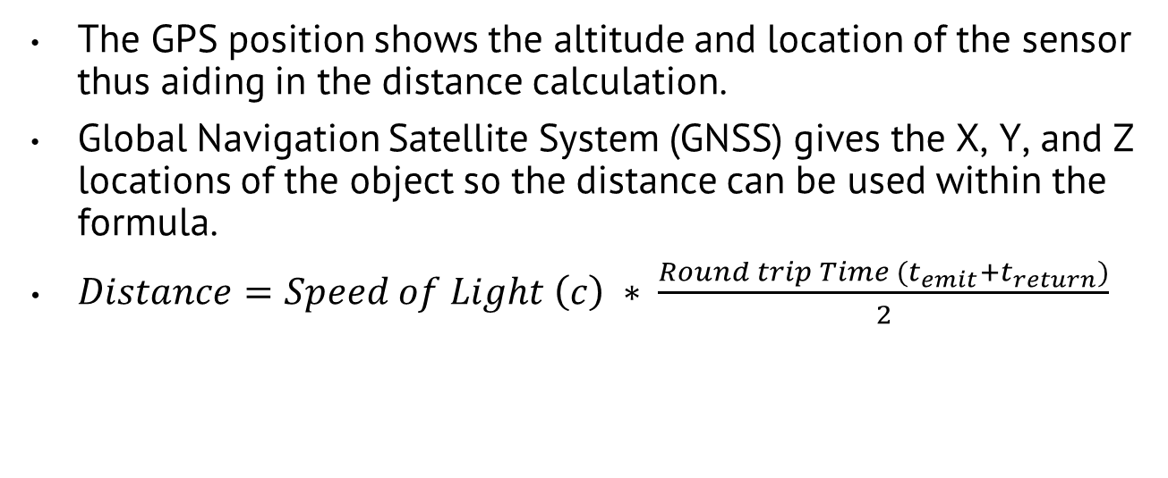
Math Behind LiDAR Sensing
The GPS position shows the altitude and location of the sensor thus aiding in the distance calculation.
Global Navigation Satellite System (GNSS) gives the X, Y, and Z locations of the object so the distance can be used within the formula.
$Distance=Speed of Light \left(c\right) ∗ \frac{Round trip Time (t_{emit}+t_{return})}{2}$
Notes:
This formula is used for every light pulse sent out, there is approximately 160,000 pulses sent out and received per second per

Slide 7
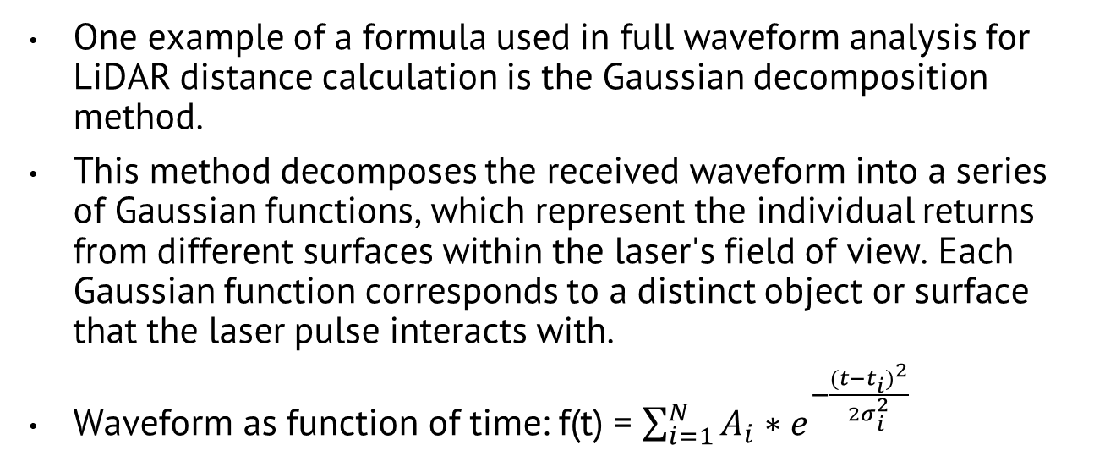
Math Behind LiDAR Sensing (continued)
One example of a formula used in full waveform analysis for LiDAR distance calculation is the Gaussian decomposition method.
This method decomposes the received waveform into a series of Gaussian functions, which represent the individual returns from different surfaces within the laser's field of view. Each Gaussian function corresponds to a distinct object or surface that the laser pulse interacts with.
Waveform as function of time: f(t) = $\sum_{i=1}^{N}{A_{i}}∗e^{−\frac{{(t−t_{i})}^{2}}{{2σ}_{i}^{2}}}$
Notes:
This formula is used for every light pulse sent out, there is approximately 160,000 pulses sent out and received per second
The formula for the Gaussian decomposition method involves fitting a series of Gaussian functions to the received waveform and extracting parameters such as the amplitude, width, and center of each Gaussian peak. These parameters provide information about the distance, intensity, and reflectivity of the surfaces that the laser pulse encounters.
f(t) is the received waveform as a function of time t.
N is the number of Gaussian peaks.
Ai​ is the amplitude of the ith Gaussian peak.
ti​ is the center time of the ith Gaussian peak.
σi​ is the standard deviation (width) of the ith Gaussian peak.
Amplitude (A): The maximum height of the peak, which represents the intensity of the reflected signal.
Center (t): The time at which the peak occurs, corresponding to the time-of-flight of the laser pulse to the reflecting surface and back.
Width (σ): The standard deviation of the peak, which determines the width of the curve at half of its maximum height. It indicates the spread or dispersion of the reflected signal in time.

Slide 8
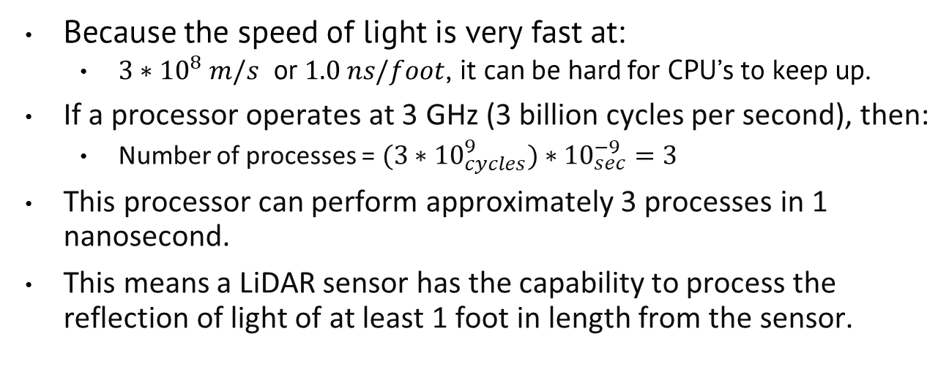
Math Behind LiDAR Sensing (continued)
Because the speed of light is very fast at:
$3∗{10}^{8} m/s$ or $1.0 ns/foot$, it can be hard for CPU’s to keep up.
If a processor operates at 3 GHz (3 billion cycles per second), then:
Number of processes = $(3∗{10}_{cycles}^{9})∗{10}_{sec}^{−9}=3$
This processor can perform approximately 3 processes in 1 nanosecond.
This means a LiDAR sensor has the capability to process the reflection of light of at least 1 foot in length from the sensor.
Notes:
This formula is used for every light pulse sent out, there is approximately 160,000 pulses sent out and received per second
The formula for the Gaussian decomposition method involves fitting a series of Gaussian functions to the received waveform and extracting parameters such as the amplitude, width, and center of each Gaussian peak. These parameters provide information about the distance, intensity, and reflectivity of the surfaces that the laser pulse encounters.
f(t) is the received waveform as a function of time t.
N is the number of Gaussian peaks.
Ai​ is the amplitude of the ith Gaussian peak.
ti​ is the center time of the ith Gaussian peak.
σi​ is the standard deviation (width) of the ith Gaussian peak.
Amplitude (A): The maximum height of the peak, which represents the intensity of the reflected signal.
Center (t): The time at which the peak occurs, corresponding to the time-of-flight of the laser pulse to the reflecting surface and back.
Width (σ): The standard deviation of the peak, which determines the width of the curve at half of its maximum height. It indicates the spread or dispersion of the reflected signal in time.

Slide 9
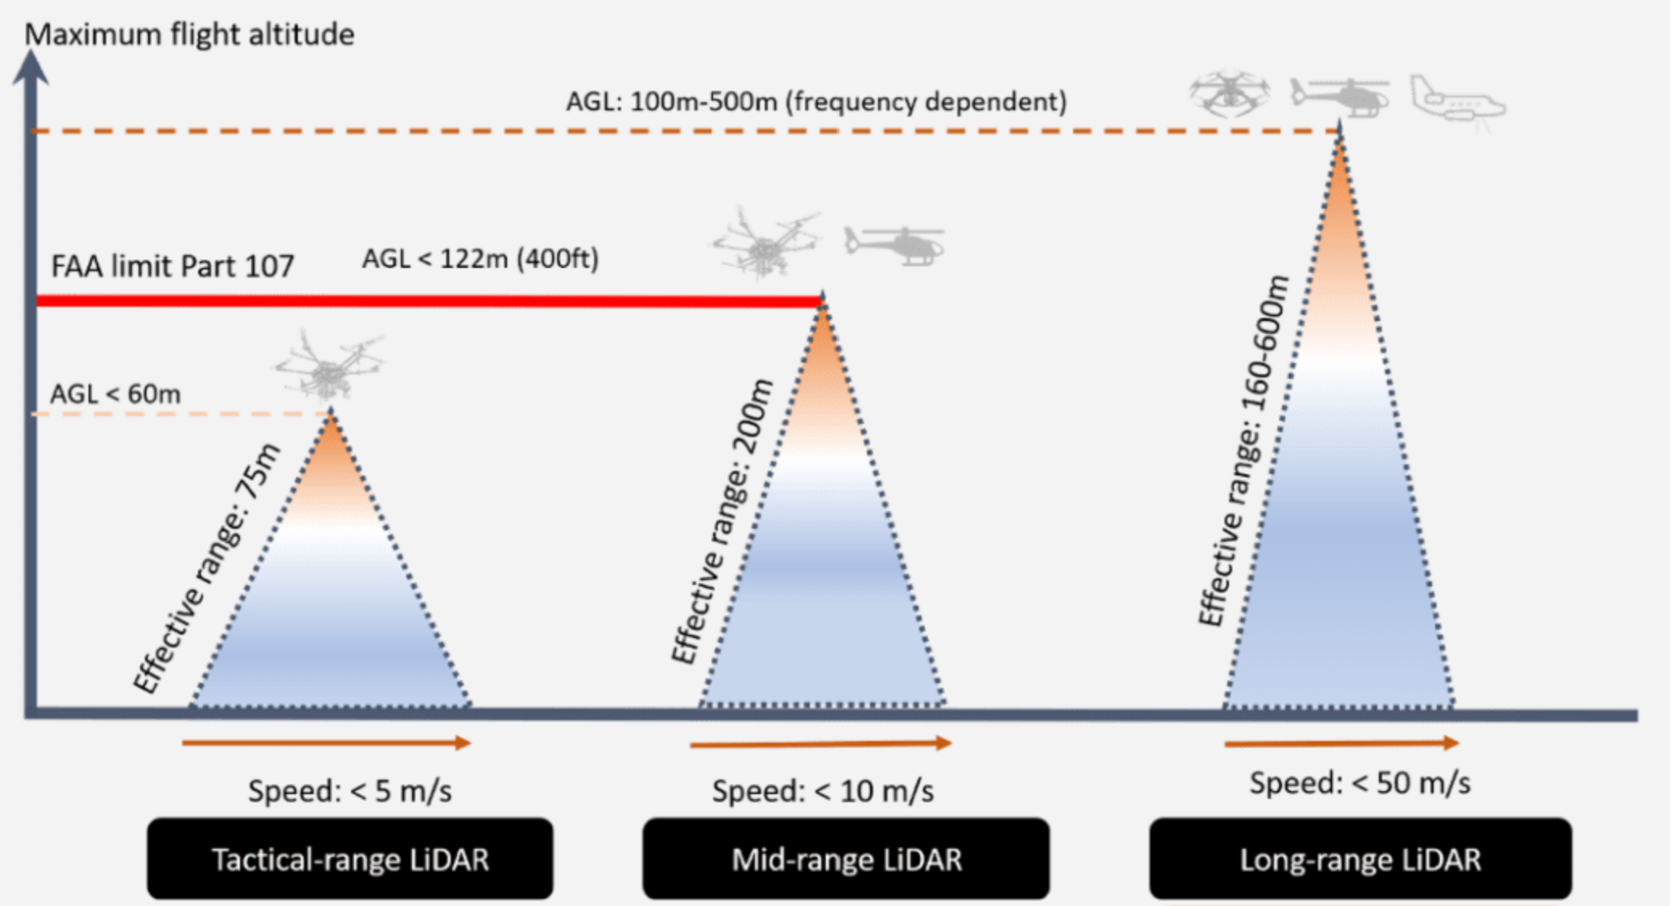
The use of LiDAR on Drones
FAA Part 107 regulations limit the altitude the drone can fly depending on the area.
LiDAR can give a 3D image of objects or the environment below.
Notes:
In LiDAR mapping, the flight altitude is a key parameter in picking the appropriate sensor. If you can fly below 60m AGL, the tactical-range sensors are appropriate. For altitudes higher than 60m, you must consider either mid-range or long-range LiDAR sensors as shown below.

Slide 10
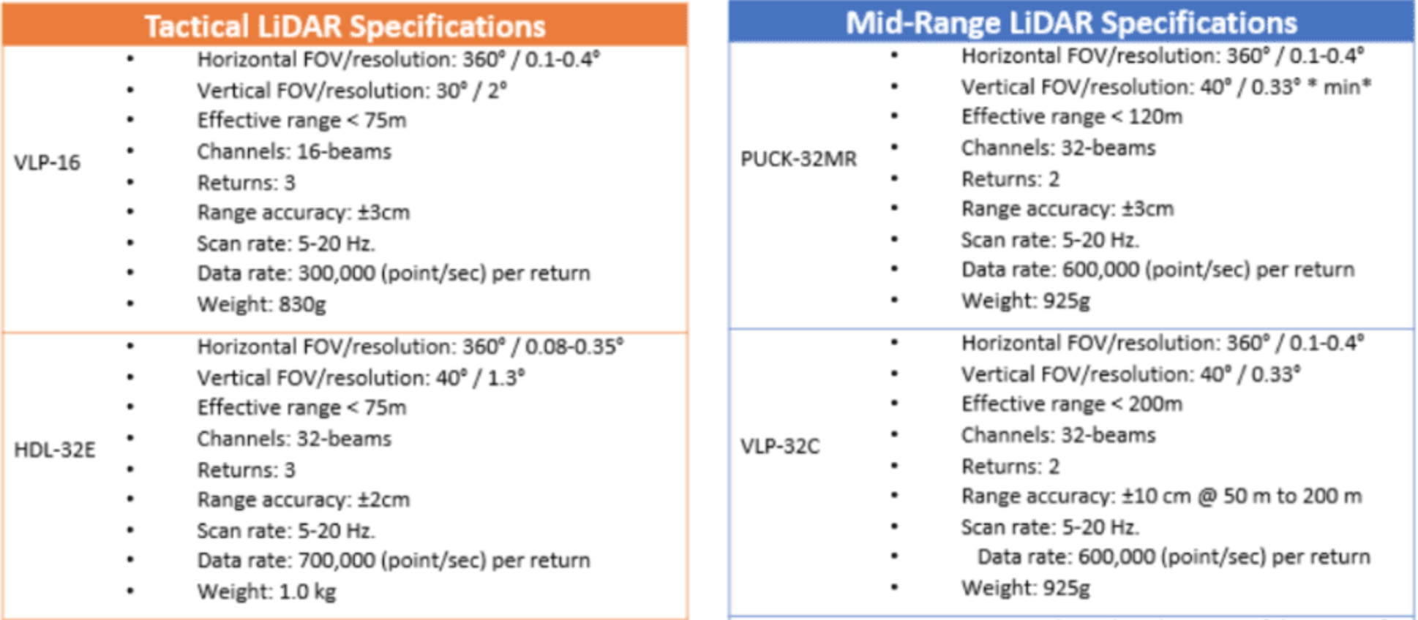
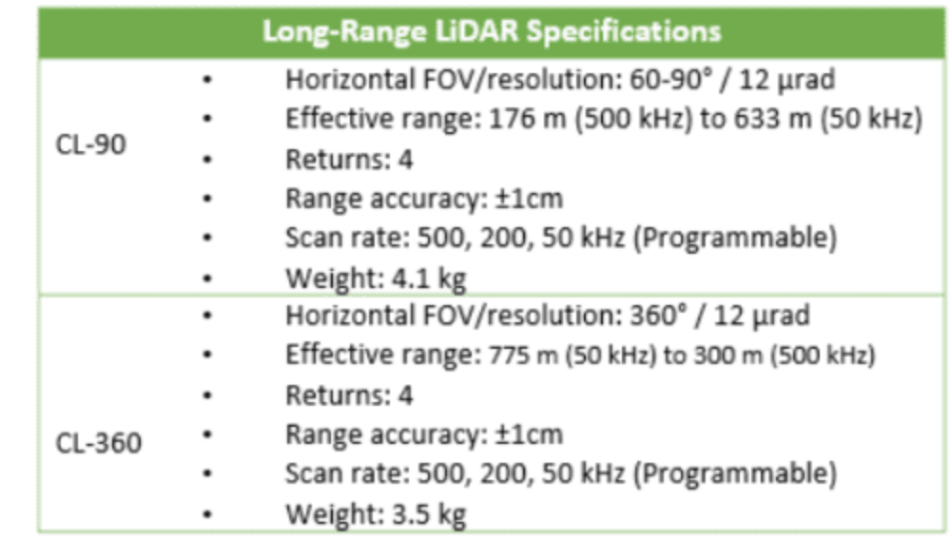














Specifications of LiDAR Sensors
Notes:
Shown above are the key specifications for LiDAR Sensors
Range: The maximum distance over where the LiDAR sensor can detect objects. This can vary from a few meters to several kilometers, depending on the sensor's design and application.
///Accuracy: The precision with which the LiDAR sensor can measure distances to objects. Accuracy is typically specified in terms of distance error, such as millimeters or centimeters.
Resolution: The level of detail or granularity in the point cloud generated by the LiDAR sensor. Resolution is determined by factors such as the beam divergence, pulse repetition rate, and scanning pattern.
Field of View (FOV): The angular extent of the area that the LiDAR sensor can scan. FOV is specified in terms of horizontal and vertical angles, which determine the coverage area of the sensor.
Scan Rate: The rate at which the LiDAR sensor can acquire data points. Scan rate is typically measured in points per second or scans per second and is influenced by factors such as pulse repetition rate and scanning pattern.
Size and Weight: The physical dimensions and weight of the LiDAR sensor. Compact and lightweight sensors are preferred for integration into drones, vehicles, or handheld devices.

Slide 11
Counter UAS Drones
Unmanned Aerial Systems are becoming increasingly more popular which means the defense of them is essential to safety
Counter UAS drones are essential for safeguarding critical infrastructure
Militaries across the world are implementing them but need as many sensors as possible to locate and eliminate drones
Notes:
such as airports, power plants, government buildings, and stadiums from potential threats posed by unauthorized or malicious drones.

Slide 12
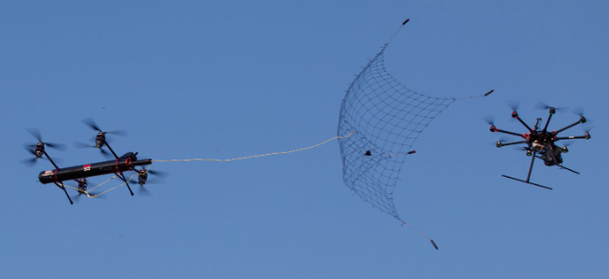
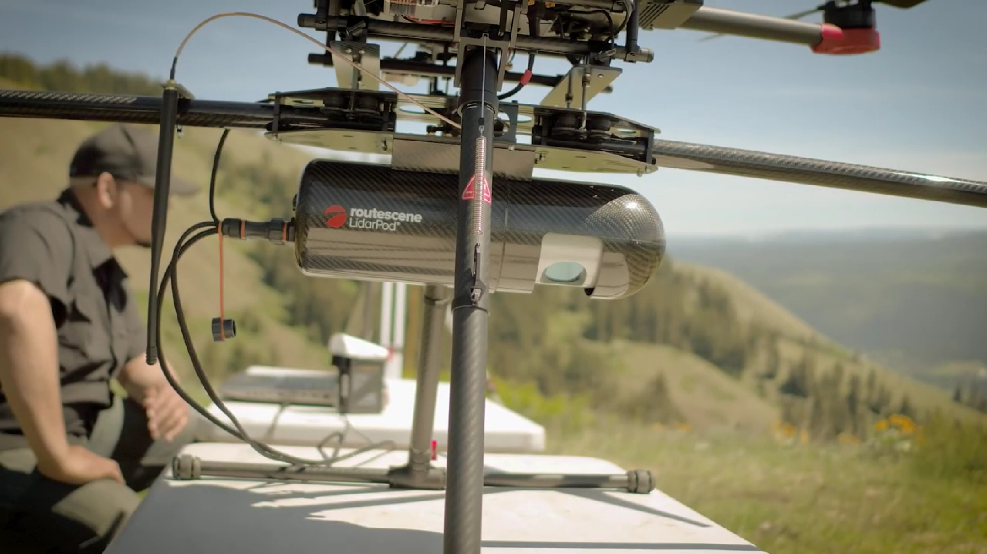
LiDAR on Counter UAS Drones
Precise Detection
3D Mapping and Targeting
Real-time Tracking
Integration with Automated Response Systems
Notes:
Precise Detection: detect even small or low-flying drones with high reliability
3D Mapping and Targeting: LiDAR sensors can create detailed 3D maps of the surrounding environment, including the airspace. This allows counter UAS drones to accurately track the movement of drones in three dimensions, facilitating precise targeting and interception maneuvers.
Real-time Tracking enables counter UAS drones to continuously monitor the position, velocity, and trajectory of intruding drones, ensuring effective response and interception.
Integration with Automated Response Systems: LiDAR data can be integrated with automated response systems on counter UAS drones, enabling rapid and autonomous decision-making. This allows drones to automatically engage and neutralize intruding drones based on pre-defined rules or algorithms.

Slide 13
Sources
https://gisgeography.com/lidar-light-detection-and-ranging/#:~:text=What%20I%20mean%20by%20that,being%20controlled%20in%20a%20platform.
https://aevex.com/selecting-the-right-lidar-sensors-for-your-drone/

